Slide 1


Evaluating the quality of training programs:
a framework crossing European standards on prevention and on elearning
ICUDDR Annual Conference – Cusco, 2019
Susana Henriques
Evaluating the quality of training programs by Susana Henriques is available under Licence Creative Commons-Atribuição-NãoComercial-CompartilhaIgual-4.0 Internacional.

Slide 2


Slide 3


Slide 4




Slide 5


Slide 6


Slide 7
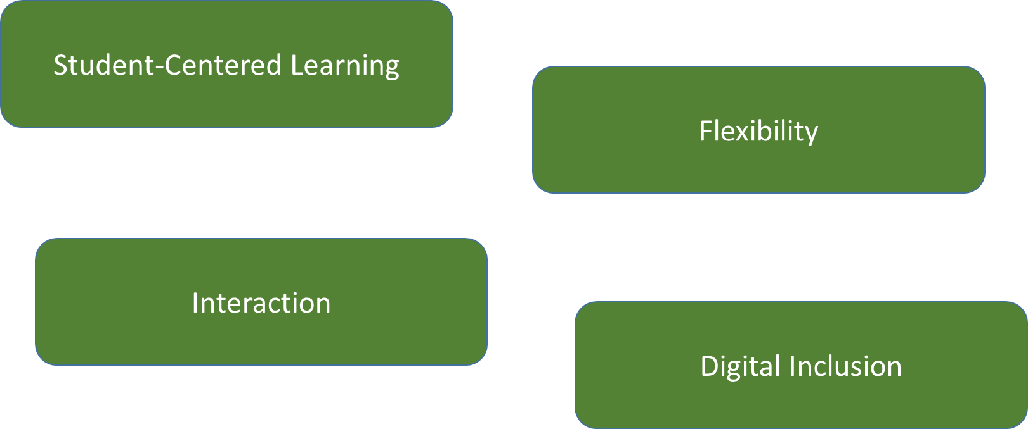

Slide 8
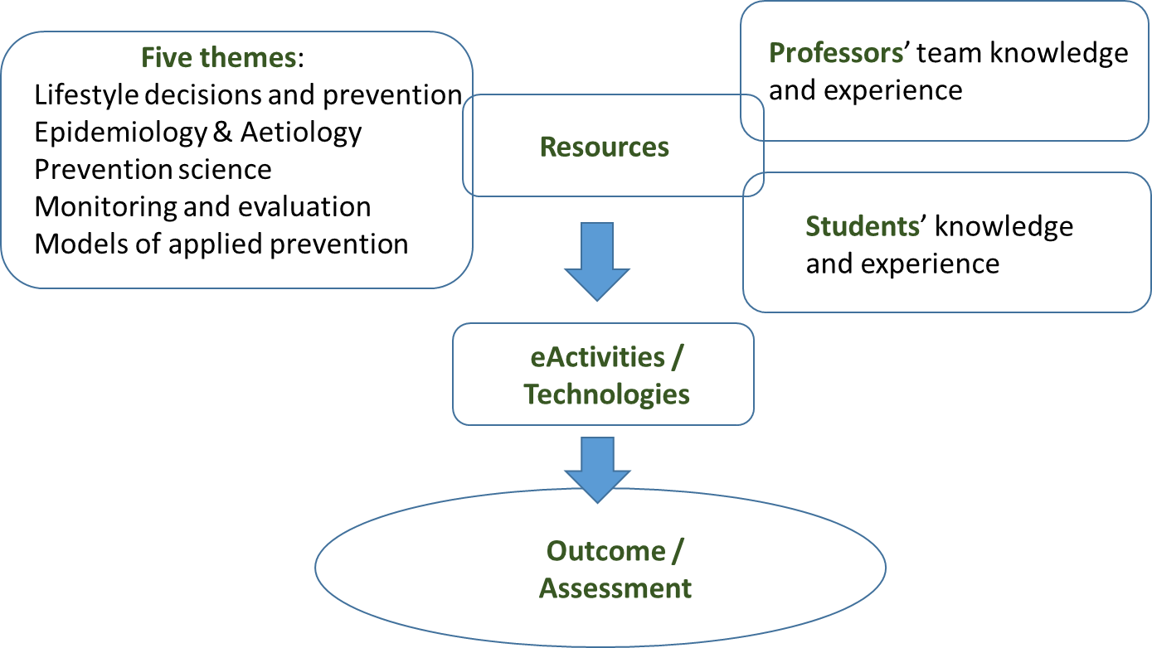

Slide 9

The Specialized Trainig Course in Prevention of Addictions

Slide 10

Quality Standards
Prevention Workforce Training
Prevention
eLearning

Slide 11
Using a theoretical model
Defining aims, goals and objectives
Setting up the team
Determining the timeline
Student-centred learning, teaching
and assessment
Teaching staff
Learning resources and students support
Information management
Recruiting and retaining participants
Decribing the need – justifying the intervention
Design and approval of programmes
Student Admission, Progression, Recognition, and Certification
Public Information
Designing for quality and effectiveness
Ongoing monitoring and periodic review of programmes
Policy for quality assurance
Cyclical external quality assurance
Label:
EMCDDA
ENQA

Slide 12

Congruent Standards

Slide 13
European Drug Prevention Quality Standards (EMCDDA, 2011) | European Standards and Guidelines for Quality Assurance of E-Learning provision – HEI (ENQA, 2018)
3.6 Determining the timeline | 1.2 Design and approval of programmes
4.1 Designing for quality and effectiveness | 1.1 Policy for quality assurance
6.3 Monitoring the implementation | 1.9 Ongoing monitoring and periodic review of programmes
8.1 Determining whether the programme should be sustained | 1.10 Cyclical external quality assurance
5.3 Setting up the team | 1.5 Teaching staff
5.4 Recruiting and retaining participants | 1.4 Student admission, progression, recognition, and certification
8.2 Disseminating information about the programme | 1.8 Public information

Slide 14

Timeline of the programme

Slide 15
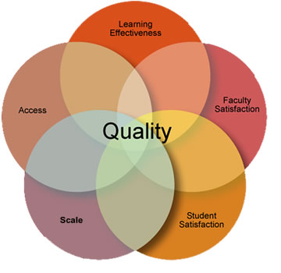

Slide 16

Recruitment and retainment of participants

Slide 17

Disseminating information

Slide 18
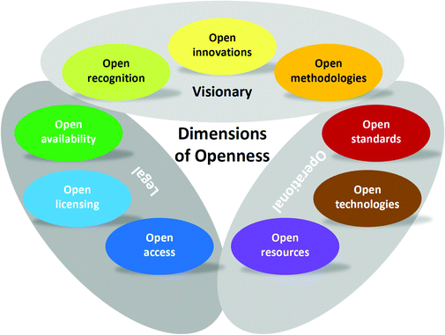

Slide 19


Slide 20
Evaluating the quality of training programs:
a framework crossing European standards on prevention and on elearning
ICUDDR Annual Conference – Cusco, 2019
Susana.Henriques@uab.pt
Evaluating the quality of training programs by Susana Henriques is available under Licence Creative Commons-Atribuição-NãoComercial-CompartilhaIgual-4.0 Internacional.

